Slide 1
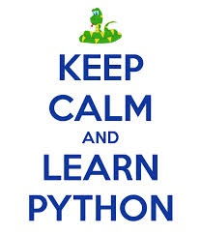
01. Introduction to Python

Slide 2
Agenda
1
Introduction
2
History
3
Python Interpreter
4
Indentation and Comments
5
Literals
6
Assignment

Slide 3
Introduction
What is Python?
Open Source
High level Programming Language
Object-oriented programming
Elegant Syntax and Dynamically Typed
Extensible and Scripted language
Where does python used?
Used in writing GUI Programming, Web development
Used in Game programming
Used in Rapid Development,Socket Programming .. So on..

Slide 4
Agenda
1
Introduction
2
History
3
Python Interpreter
4
Indentation and Comments
5
Literals
6
Assignment

Slide 5
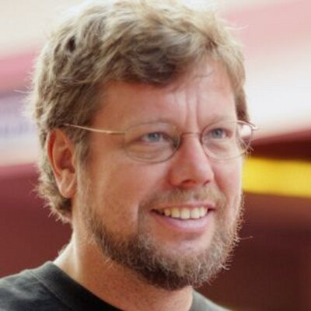
History
Python was Invented in December 1989 by Guido van Rossum
“ I chose Python as a working title for the project, being in a slightly irreverent mood (and a big fan of Monty Python's Flying Circus.”
Version : 2.7.10 and 3.5.XX

Slide 6
Agenda
1
Introduction
2
History
3
Python Interpreter
4
Indentation and Comments
5
Literals
6
Assignment

Slide 7
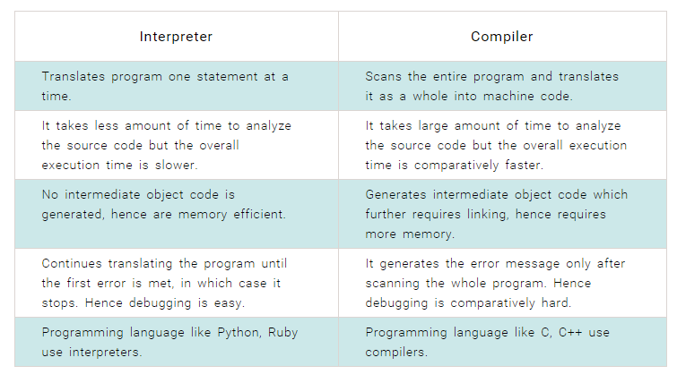
Python Interpreter

Slide 8
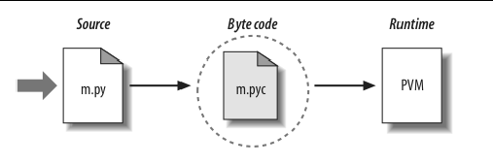
Python Interpreter

Slide 9
Agenda
1
Introduction
2
History
3
Python Interpreter
4
Indentation and Comments
5
Literals
6
Assignment

Slide 10
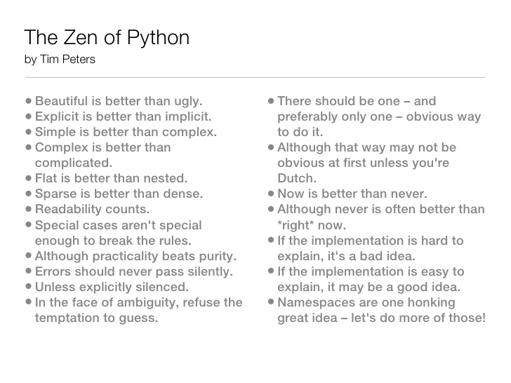
Zen of the Python

Slide 11
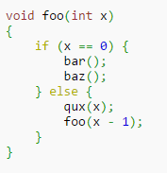
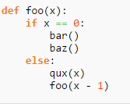


Indentation

Slide 12
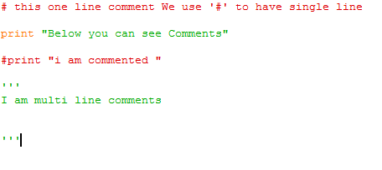
Comments

Slide 13
Agenda
1
Introduction
2
History
3
Python Interpreter
4
Indentation and Comments
5
Literals
6
Assignment

Slide 14
Literals and variables
counter = 100 # An integer assignment
miles = 1000.0 # A floating point
NAME = "John" # A string print counter print miles print name
a = b = c = 1
a, b, c = 1, 2, "john"

Slide 15
Agenda
1
Introduction
2
History
3
Python Interpreter
4
Indentation and Comments
5
Literals
6
Assignment

Slide 16
Assignment

